Slide 1

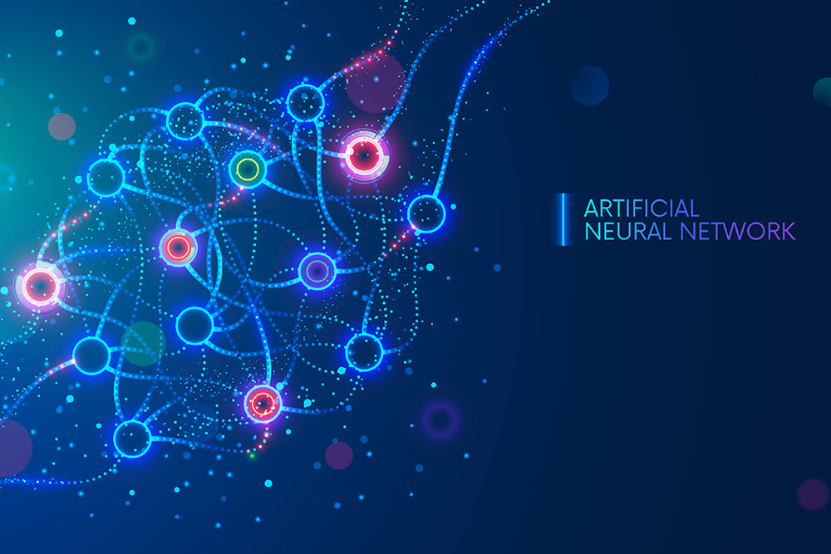
Artificial Neural Network

Slide 2
Objectives
Agenda
Introduction to Neural Networks
BNN VS ANN
How does Neural Networks work
Activation functions
How does Neural Networks learn
Gradient Descent
Building Deep Learning Model Using ANN
Evaluating Improving and Tuning ANN

Slide 3

Artificial Neural Network
Artificial Neural network is a computing system inspired by analogy of biological neurons, which is used to process the information as a human brain does.
.

Slide 4
Topology of ANN
Generally ANNS Use feed Forward Network which consists of different layers namely Input, Hidden and Output layers.
Input Layer
Hidden layers
Output Layer

Slide 5
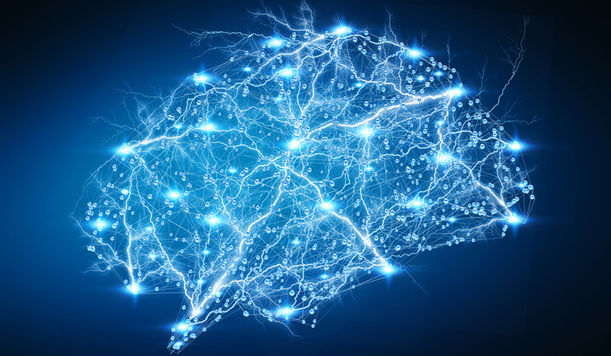
What is a Biological Neuron?
Notes:
BI&DW
integration.intelligence.insight
5

Slide 6
Dendrites
Cell Body
Axon
Synapse

Slide 7
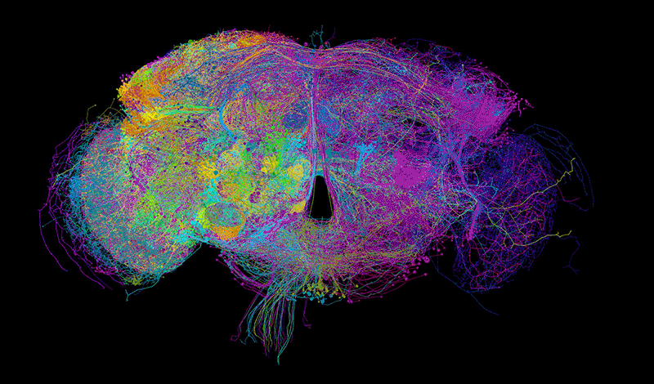
What is an Artificial Neuron?
Notes:
BI&DW
integration.intelligence.insight
7

Slide 8
Input
W1
Activation Function
W2
F
Input
Node
Y
Wn
Output
Output value may be:
Continuous
Binary
Categorical
Input
Artificial Neuron is also called as Perceptron

Slide 9
Artificial Neuron VS Biological Neuron
Biological Neural Network BNN | Artificial Neural Network ANN
Soma | Node
Dendrites | Input
Synapse | Weights or Interconnections
Axon | Output

Slide 10
How Does this Perceptron Work?
Y
Input
W1
W2
?
Y
Input
W3
Y
Input

Slide 11
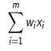
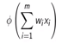
Working of a Preceptron
Step 1:
initialize the weights near to zero but not zero
Inputs are multiplied with respect to its weights and their Respective sum is taken
This Sum is passed through an activation Function to get the resultant output
Step 2:
This Sum is passed through an activation Function
Step 3:
The activation output is considered as resultant output
X1
W1
X2
W2
Step1
Output
Step2
Step3
X3
W3
W4
X4

Slide 12

Why weights?
Will having Loan effects the salary ??
Theoretically weights determine the importance of inputs and mathematically weights are just slope of the line
OUTPUT
W1
What would be his salary?
Experience
W2
Loan

Slide 13
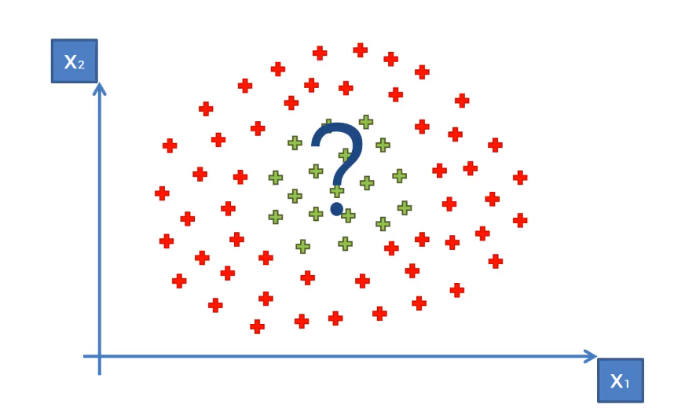
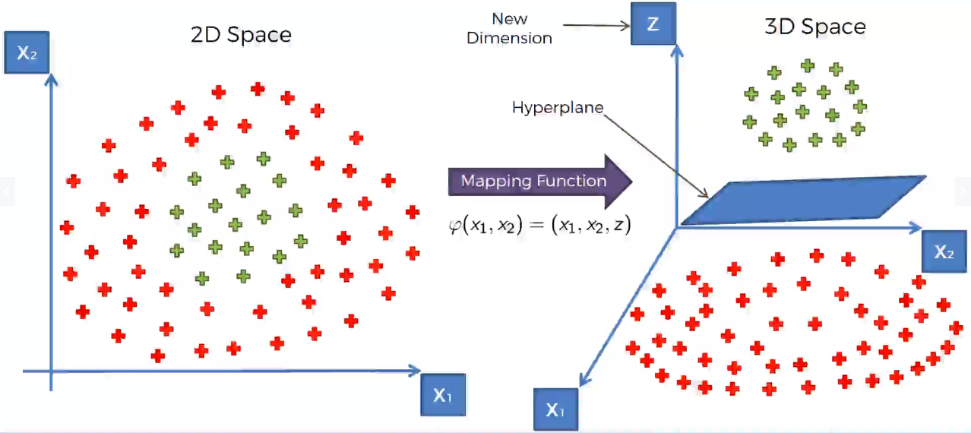
Why Activation Function?
Mapping it to higher dimension can make points linearly separable
Data Points are not linearly separable
Activation function is used to transform in non linearly separable data to linearly separable data which helps to learn and preform more complex tasks.
Neural Network without an activation function is just a linear regression model.

Slide 14
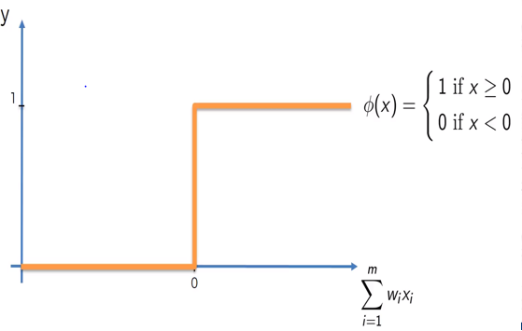
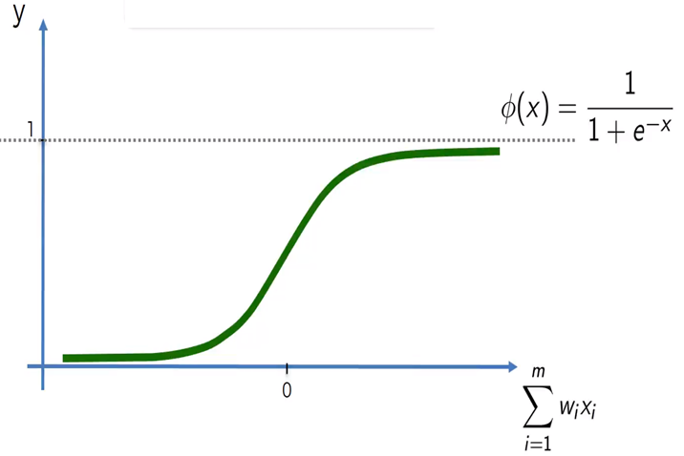
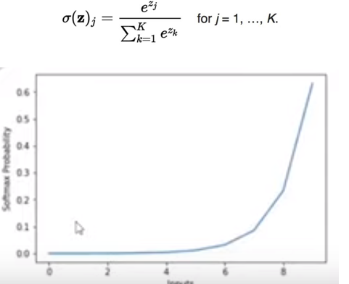
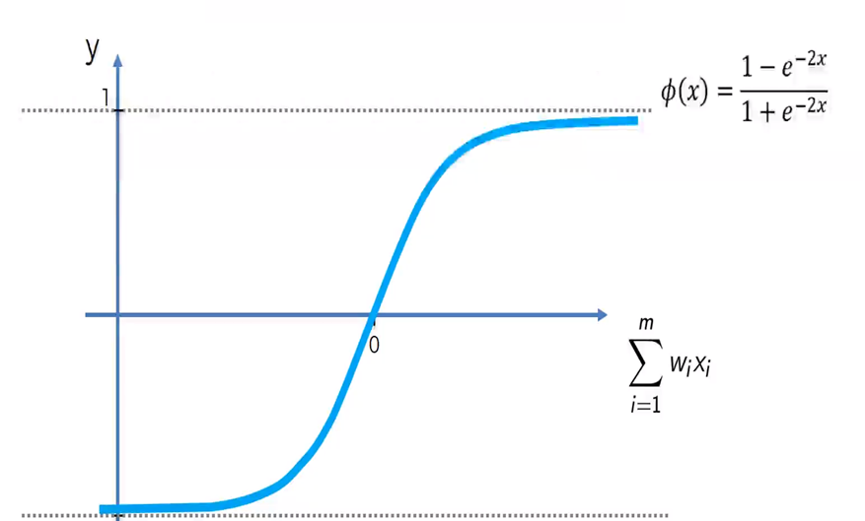
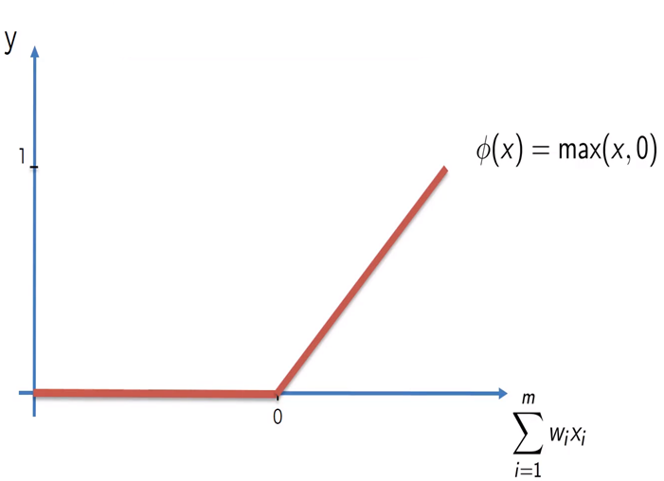
Types of activation Functions
Threshold Function
Sigmoid Function
Softmax Function
Relu
Tanh Function

Slide 15

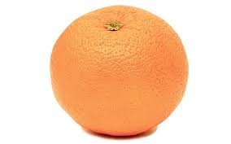
How does ANN’s Learn?
Perceptron or Artificial Neuron is trained in such a way that it finds a line which separates the different classes by adjusting the weights and bias
Error = 3
Error = 1
Error = min

Slide 16
Rank he secured | Hrs. of study | Past percentage | Exam
2 | 12 | 84% | 87%
2
0.2
12
0.6
F
Y
-0.2
84

Slide 17
Rank he secured | Hrs. of study | Past percentage | Exam
2 | 12 | 84% | 87%
2
(2*(-0.2))+(12*0.6)+(84*0.2) = 23.6
-0.2
F
Y
12
0.6
0.2
84

Slide 18
Rank he secured | Hrs. of study | Past percentage | Exam
2 | 12 | 84% | 87%
2
-0.2
Rectified Linear Unit
12
23.6
Ø(23.6)
Y
0.6
0.2
84

Slide 19
Rank he secured | Hrs. of study | Past percentage | Exam
2 | 12 | 84% | 87%
2
Rectified Linear Unit
Output value y^
-0.2
12
23.6
Ø(23.6)
23.6
0.6
0.2
Actual value y
84
87

Slide 20
Rank he secured | Hrs. of study | Past percentage | Exam
2 | 12 | 84% | 87%
Forward Propagation
2
Rectified Linear Unit
-0.2
Output value y^
12
23.6
Ø(23.6)
23.6
0.6
0.2
C = ½(y^-Y)²
84
Actual value y
87

Slide 21
Rank he secured | Hrs. of study | Past percentage | Exam
2 | 12 | 84% | 87%
Back Propagation
2
Changed
Rectified Linear Unit
Output value y^
12
23.6
Ø(23.6)
23.6
C = ½(y^-Y)²
84
Changed
Actual value y
87

Slide 22
Rank he secured | Hrs. of study | Past percentage | Exam
2 | 12 | 84% | 87%
2
Optimized weights
Rectified Linear Unit
Output value y^
12
87
Ø(87)
87
C = ½(y^-Y)²
84
Optimized weights
Actual value y
87

Slide 23
F
y’
F
y’
C1
C4
y
y
Rank he secured | Hrs. of study | Past percentage | Exam
2 | 12 | 84% | 87%
10 | 10 | 62% | 72%
30 | 0 | 59% | 50%
5 | 8 | 79% | 76%
1 | 10 | 87% | 77%
7 | 7 | 64% | 0%
F
y’
F
y’
C2
C5
y
y
F
y’
C3
F
y’
y
C6
y
C = C1+C2+C3+C4+C5+C6

Slide 24
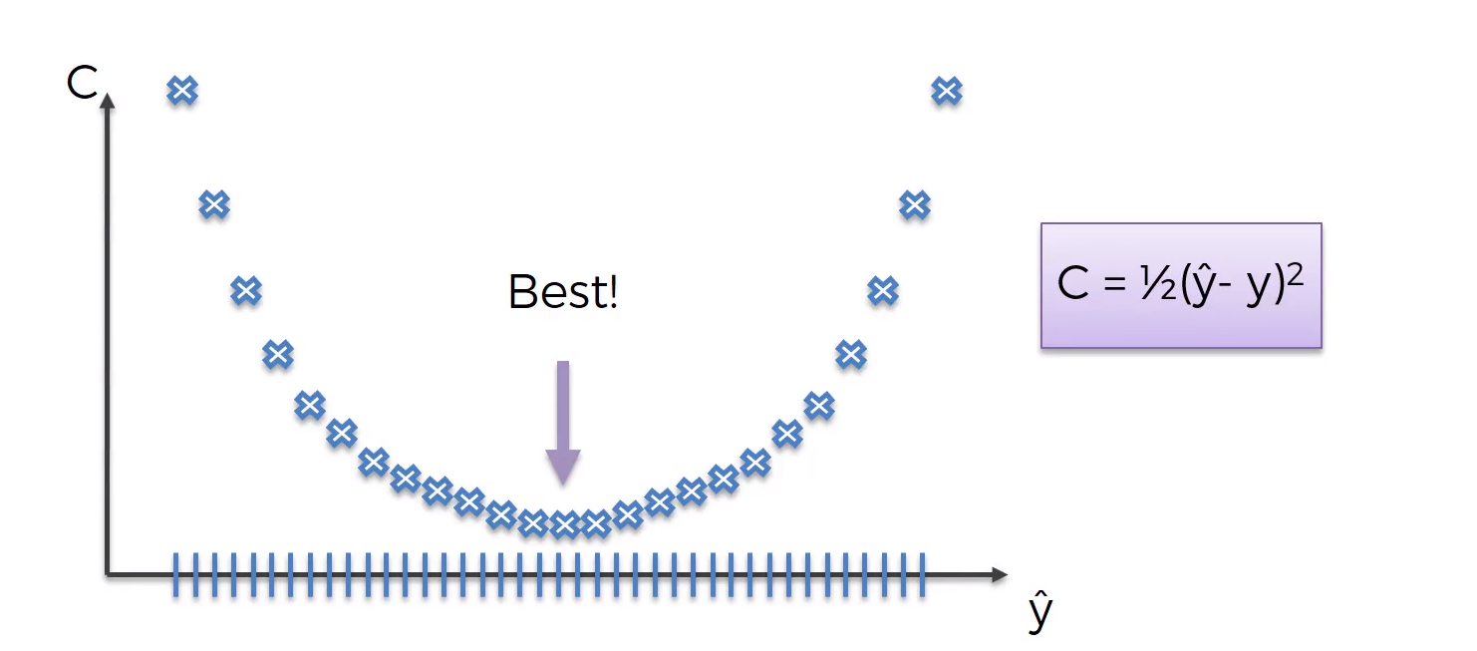
Gradient Descent
The concept of minimizing the cost function error to get optimized weights is called gradient descent
Types :
Stochastic Gradient descent
Batch Gradient Descent

Slide 25
Mini Batch Gradient Descent
Rank he secured | Hrs. of study | Past percentage | Exam
2 | 12 | 84% | 87%
10 | 10 | 62% | 72%
30 | 0 | 59% | 50%
5 | 8 | 79% | 76%
1 | 10 | 87% | 77%
7 | 7 | 64% | 0%
FP/BP Upw
FP/BP Upw

Slide 26
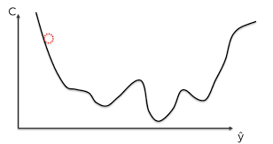
Stochastic Gradient Descent
Rank he secured | Hrs. of study | Past percentage | Exam
2 | 12 | 84% | 87%
10 | 10 | 62% | 72%
30 | 0 | 59% | 50%
5 | 8 | 79% | 76%
1 | 10 | 87% | 77%
7 | 7 | 64% | 0%
FP/BP Upw
FP/BP Upw
FP/BP Upw
FP/BP Upw
FP/BP Upw
FP/BP Upw

Slide 27
Multi layered Perceptron
2 inputs and 28 weights
x1
x2
Input
Hidden layers
Output Layer

Slide 28
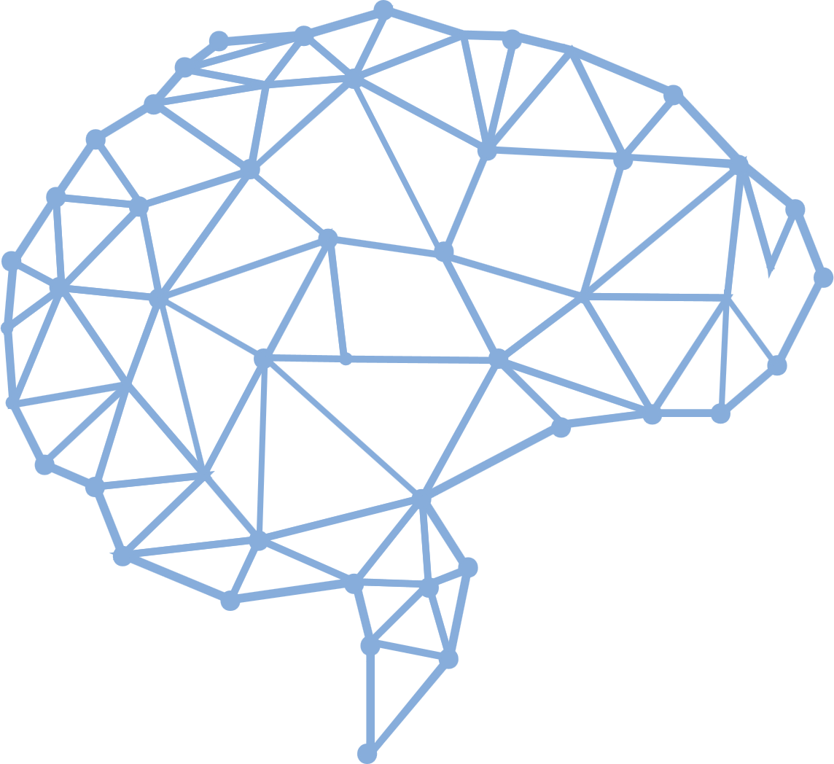
Speech
OUTPUT
Image
x | x | y
2 | 2 | 1
1 | 2 | 0
Artificial Neural network
Un Structured Data
Structured Data

